Slide 1
Introduction to AdaBoost, XG Boosting and LG Boosting

Slide 2
What is AdaBoost?
Short for Adaptive Boosting: A popular Machine Learning algorithm.
Ensemble Method: Combines multiple weak models to build a single strong model.
Key Term: Weak Learner
A simple classifier that performs slightly better than random
guessing (e.g., a 1-split Decision Tree).
Adaptive Learning: Learns from previous mistakes by giving more weight to misclassified data.

Slide 3
How AdaBoost Works (Step-by-Step)
Step 1:
Assign equal weight to all data points at the start.
Step 2:
Train a simple weak model (Decision Stump) on the dataset.
Step 3:
Increase weights for incorrectly classified data points.
Step 4:
Repeat the process and combine all models for the final prediction.

Slide 4

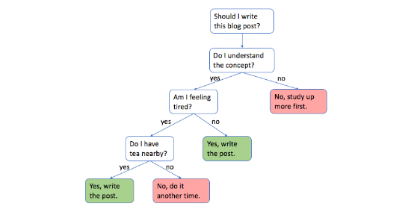
Decision Stumps
A Decision Stump is a Decision Tree with only one split.
It makes a decision based on just one single feature.
AdaBoost combines dozens of these simple stumps together.

Slide 5
Advantages & Disadvantages
Advantages
Disadvantages
•
•
Easy to understand and implement.
Sensitive to noisy data and outliers.
•
•
Dramatically improves accuracy.
Requires clean data preprocessing.
•
•
Less prone to overfitting in clean data.
Slower training compared to single models.

Slide 6
What is XGBoost?
Extreme Gradient Boosting: An advanced machine learning library built for efficiency and speed.
Gradient Boosting Framework: Builds decision trees sequentially to minimize remaining errors.
Core Philosophy
Instead of building one complex model, train multiple simple
decision trees step-by-step to correct past mistakes.
Industry Standard: Widely used in Kaggle competitions and real-world enterprise applications.

Slide 7
How XGBoost Works (Step-by-Step)
Step 1:
Start with an initial base prediction (e.g., average target value).
Step 2:
Calculate residuals (actual values minus predicted values).
Step 3:
Fit a new decision tree to predict these residual errors.
Step 4:
Add the new tree to the ensemble and repeat until target accuracy is achieved.

Slide 8
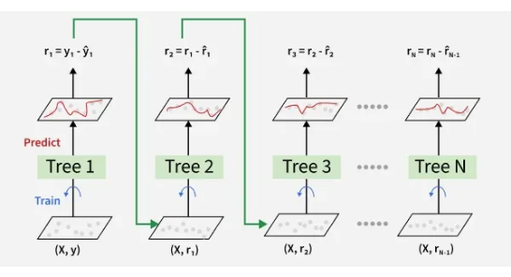
Tree Architecture
Combines predictions from multiple weak trees into one strong output.
Uses learning rate (eta) to scale down each tree's contribution.
Prevents any single tree from dominating the final decision.

Slide 9
AdaBoost vs. XGBoost
Feature | AdaBoost | XGBoost
Base Model | Decision Stumps (1-split) | Deeper Decision Trees
Error Correction | Increases sample weights | Fits trees on residual errors
Regularization | No built-in regularization | Built-in L1 & L2 regularization
Speed & Scale | Moderate speed | Highly optimized & parallelized

Slide 10
Advantages & Disadvantages
Advantages
Disadvantages
Top-tier accuracy on structured/tabular data.
Requires hyperparameter tuning for best results.
Built-in handling of missing data points.
Less readable than a single decision tree.
Fast training with GPU and CPU parallelization.
Can overfit if learning rate is too high.

Slide 11
What is LightGBM?
Light Gradient Boosting Machine: A high-performance gradient boosting framework developed by Microsoft.
Designed for Efficiency: Built specifically for fast training speed and lower memory usage on huge datasets.
Core Philosophy
Optimize both computational efficiency and memory overhead
while maintaining high modeling accuracy on large-scale data.
Leaf-Wise Tree Growth: Splits nodes based on maximum loss reduction rather than level by level.

Slide 12
How LightGBM Works (Step-by-Step)
Step 1:
Convert continuous feature values into discrete bins to construct histograms.
Step 2:
Filter data instances using Gradient-Based One-Side Sampling (GOSS).
Step 3:
Bundle mutually exclusive sparse features together via EFB.
Step 4:
Grow trees leaf-wise by splitting the leaf with the largest loss reduction.

Slide 13
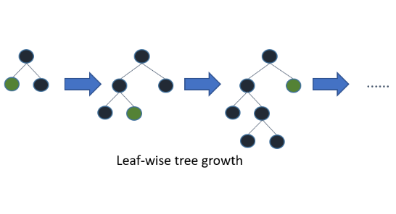
Leaf-Wise vs. Level-Wise Tree Growth
Traditional (Level-Wise): Grows the tree balanced layer by layer across all leaves.
LightGBM (Leaf-Wise): Expands only the leaf node that produces the largest error drop.
Achieves lower overall loss faster than level-wise tree growth.

Slide 14
XGBoost vs. LightGBM
Feature | XGBoost | LightGBM
Tree Growth Strategy | Level-Wise (Depth-Wise) | Leaf-Wise (Best-First)
Training Speed | Fast on medium datasets | Extremely fast on massive data
Memory Consumption | Higher RAM usage | Lower RAM usage (Histograms)
Small Dataset Behavior | Handles small data well | Can overfit on very small data

Slide 15
Advantages & Disadvantages
Advantages
Disadvantages
Rapid training speeds on large datasets.
Prone to overfitting on small datasets (< 10k rows).
Low memory footprint due to binning.
Sensitive to hyperparameters (e.g., max_depth).
Native handling of categorical features.
Leaf-wise growth can produce complex, deep trees.

